Slide 1
Writing an advert to sell a roman villa

Slide 2
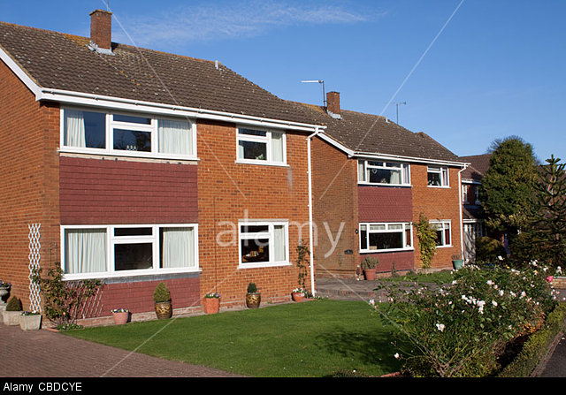
What are the features of houses near school?
List some features
entrance hall
lounge/ living room/ reception room
stairs
kitchen
conservatory
dining room
bedrooms
bathroom
wc
study / office

Slide 3
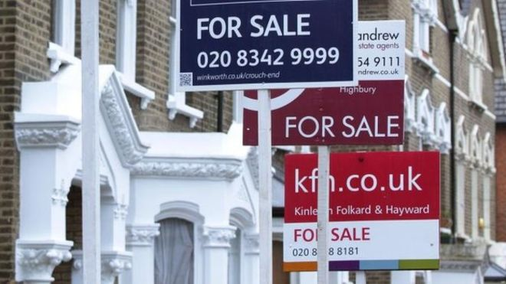
When people move, they have to sell their house. An Estate Agent helps to sell the house for them by advertising it.

Slide 4
Here are some of words that Estate Agents use to sell houses. These words are used to make the house seem very nice to buyers.
Common words | ‘Estate Agent word’
nice | beautiful
very nice | stunning, superb
quite nice | attractive
big | spacious
quite big | good-sized
really want it | highly desirable
other nice things | further benefits
nicely decorated | beautifully decorated

Slide 5
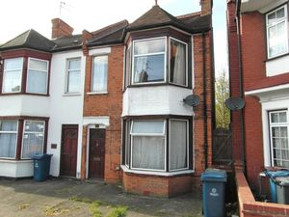
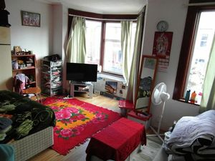
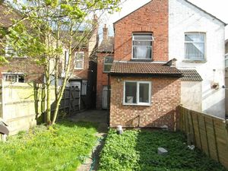
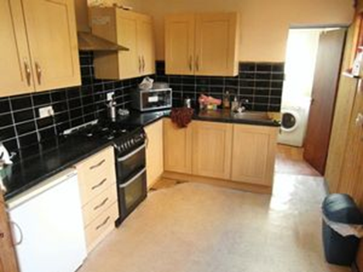
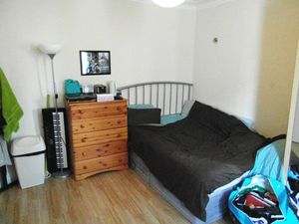
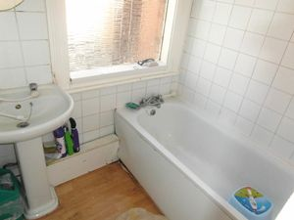
.......house
.....bedroom
.....garden
......kitchen
......bedroom
.....bathroom
Which words fit best with the features of this house?
attractive
beautiful
superb
stunning
large
spacious
good-sized
newly decorated
beautifully decorated

Slide 6
Match the words on the left to the words on the right
spacious | gas central heating and double-glazing
attractive | kitchen
situated close to | rear garden
accommodation | bedrooms
good-sized | entrance hallway, lounge and dining room
further benefits include | train station and popular schools

Slide 7
Active Listening
A spacious three bedroom house is for sale with Robertson Phillips Estate Agents.
This property is situated close to shops, popular schools including Vaughan school and St Anselm's and Metropolitan line train station.
Accommodation: Entrance hallway, lounge, dining room, spacious kitchen/breakfast room, landing, three good sized bedrooms and family bathroom with w.c.
Further benefits include gas central heating, double glazing and an attractive rear garden.
All the words in red are used by the estate agent to try to sell the house. These are the house’s best features.

Slide 8
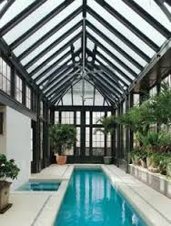
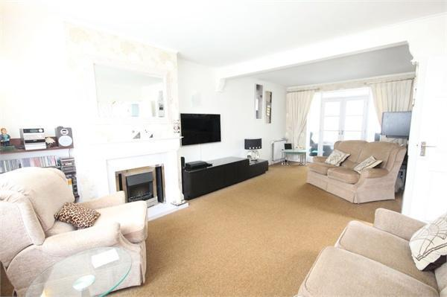
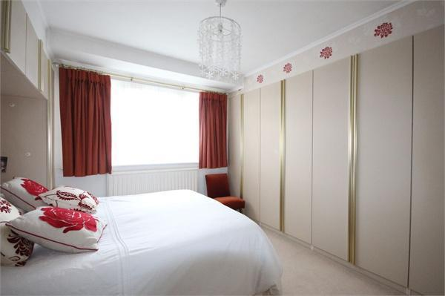
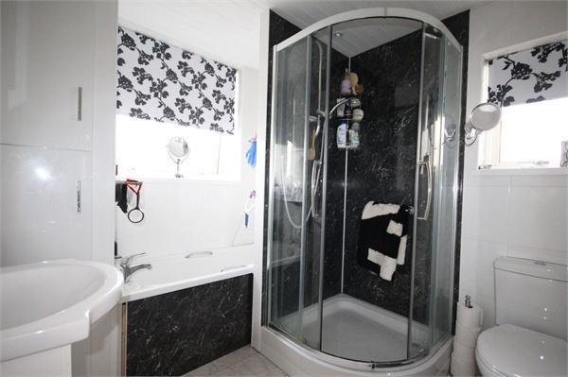
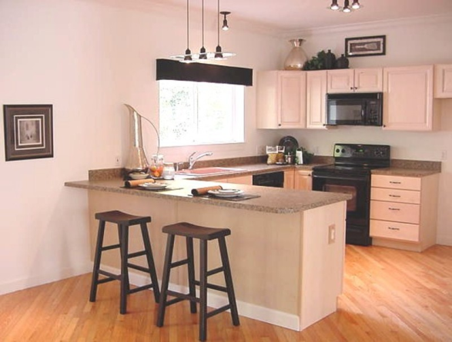
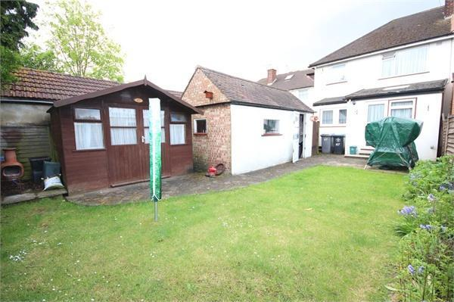
Some features of a house
Which feature might be the special feature?
lounge
main bedroom
conservatory
bathroom
kitchen
rear garden
with shower cubicle and wc
with patio and log cabin
with electric fire
with radiator and fitted wardrobes
with pool
with breakfast bar

Slide 9
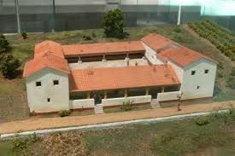
Roman villa for sale
Read the sentence out aloud.
We are delighted to offer for sale this superb six bedroom villa close to the gates of Londinium, with a spacious garden and large courtyard.

Slide 10
Roman villa for sale
Read the sentence out aloud
Add the words in the gaps
We are delighted to offer for sale this ........... six bedroom villa close to the gates of Londinium, with a .............. garden and ............ courtyard.

Slide 11
Roman villa for sale
Read the sentence out aloud.
Add the words in the gaps.
We are ............ to offer for sale this superb six bedroom .......... .. ...... the gates of Londinium, with a ............. garden and ............ courtyard.

Slide 12
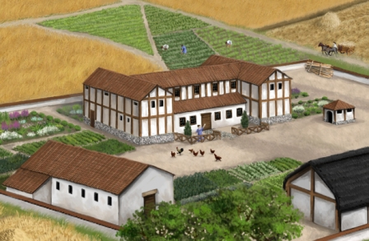
What do you think are the features of this house? Describe one feature on a post-it note.

Slide 13
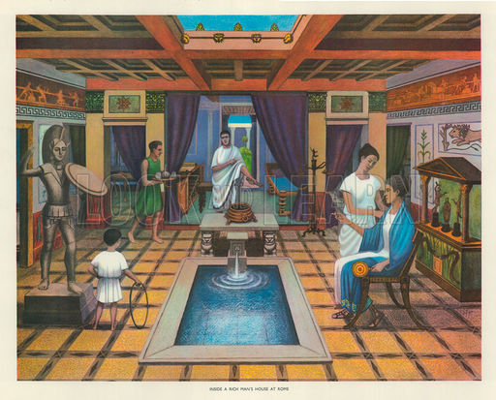
What are the features of this room which cannot be removed?
decorated walls
altar with gods
fountain
tiled floor
pool
underfloor heating

Slide 14
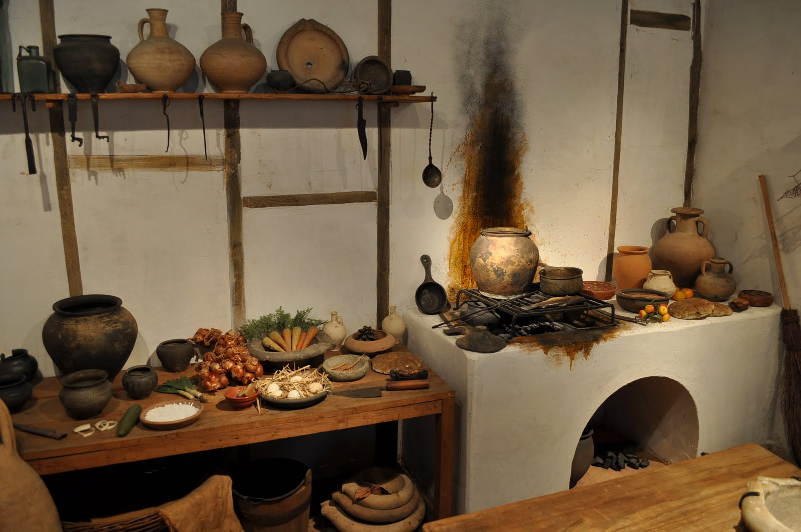
What are two features of this kitchen that cannot be removed?
wood-fired oven
Shelf for storing food and wine

Slide 15
In groups of three, choose one roman villa.
Describe the features of your villa on post-it notes.
Then use the framework to write record the features of your villa

Slide 16
Framework
For sale
Situated close to
Accommodation (list of features)
Other benefits

Slide 17
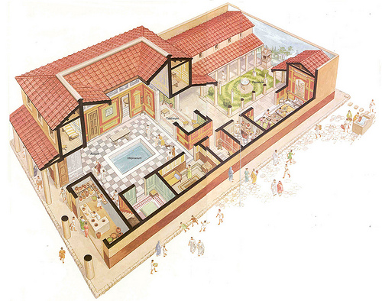
Roman Villa 1

Slide 18
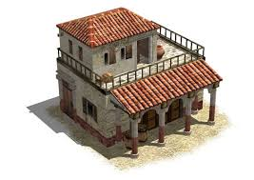
Roman villa 2

Slide 19
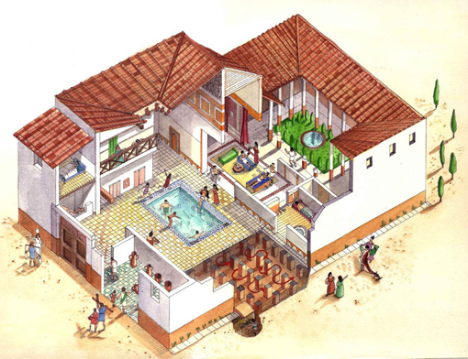
Roman villa 3

Slide 20
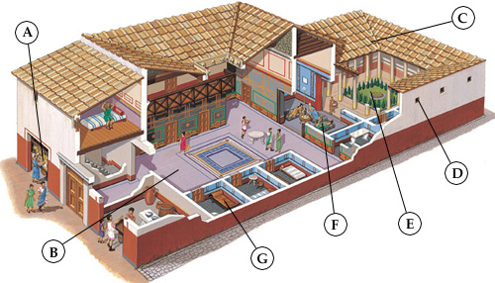
Roman villa 4

Slide 21
My advert to sell a roman villa
Name…………………………………………………… Date……………………………………
FOR SALE
A …………………………………………………………………………………………………………………
Where it is located?
What rooms are in it? (Accommodation)
What features the house has
A special feature

Slide 22
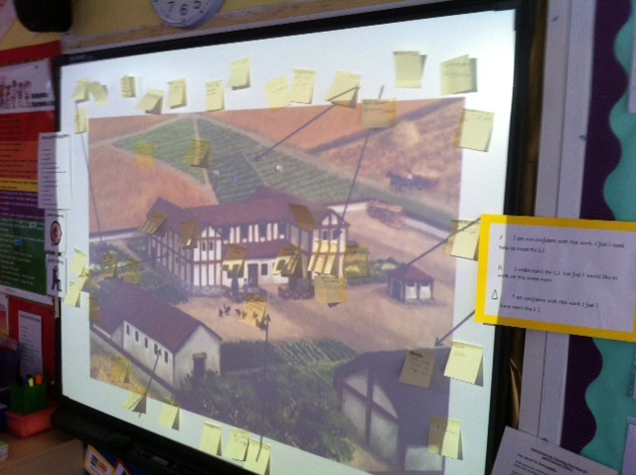

Slide 23
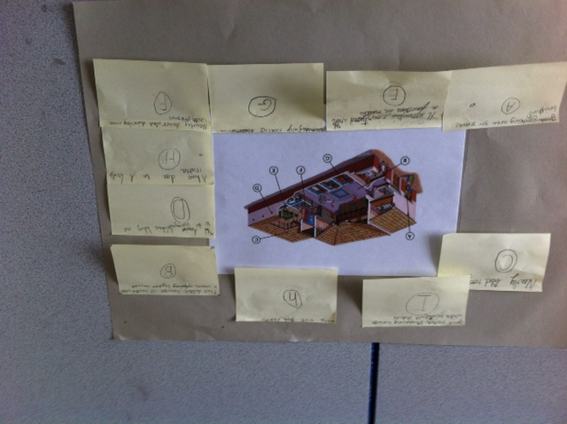

Slide 24
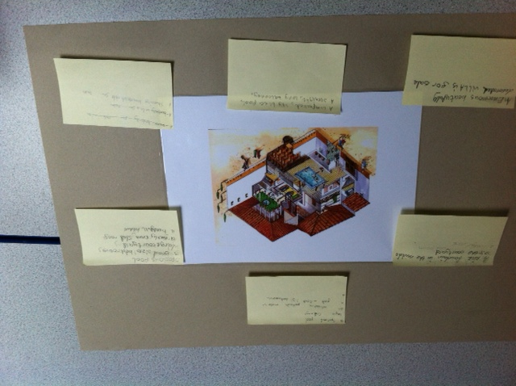

Slide 25
